Slide 1
Lab 5 IoT Wired Communication Protocols
2021.05.06

Slide 2
Wired Communication for IoT
Internal wired communication
I2C
SPI
External wired communication
Ethernet
RS-232
RS-485
UART/USART
USB
Notes:
https://www.strongpilab.com/rs232-uart-difference/

Slide 3


Half-Duplex/Full-Duplex
Half-Duplex
Ex. Walkie-Talkie
Full-Duplex
Ex. Telephone

Slide 4
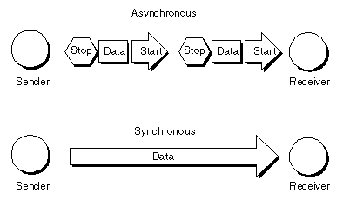
Synchronous/Asynchronous
Synchronous
A clock signal is required
Need to take clock skew into consideration
Consume more power -> clock gating
(extra circuit, extra delay from synchronous)
Less information within a single transmission
Asynchronous
Add extra information when transmit data
Low cost and setup time
Can communicate between machines with different clock
Less information within a single transmission
來源: http://wiki.csie.ncku.edu.tw/embedded/USART
Notes:
http://wiki.csie.ncku.edu.tw/embedded/USART#synchronous-%E5%90%8C%E6%AD%A5%E5%82%B3%E8%BC%B8

Slide 5
ModBus over EIA-485
A serial communications protocol
Originally published by Modicon (now Schneider Electric) in 1979
For use with its programmable logic controllers (PLCs)
Has become a standard communication protocol and a commonly available means of connecting industrial electronic devices
openly published and royalty-free
relatively easy to deploy and maintain
places few restrictions
Notes:
https://zh.wikipedia.org/wiki/Modbus
1970’s

Slide 6
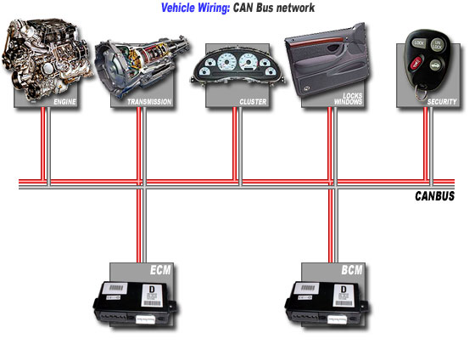
Controller Area Network (CAN or CAN bus) over EIA-485
CAN Bus is an automotive bus developed by Robert Bosch
quickly gained acceptance into the automotive and aerospace industries
connect individual systems and sensors as an alternative to conventional multi-wire looms.
allows automotive components to communicate on a single or dual-wire networked data bus up to 1Mbps
資料來源: https://canbuskit.fortin.ca/what.php
Notes:
https://canbuskit.fortin.ca/what.php
1980’s

Slide 7
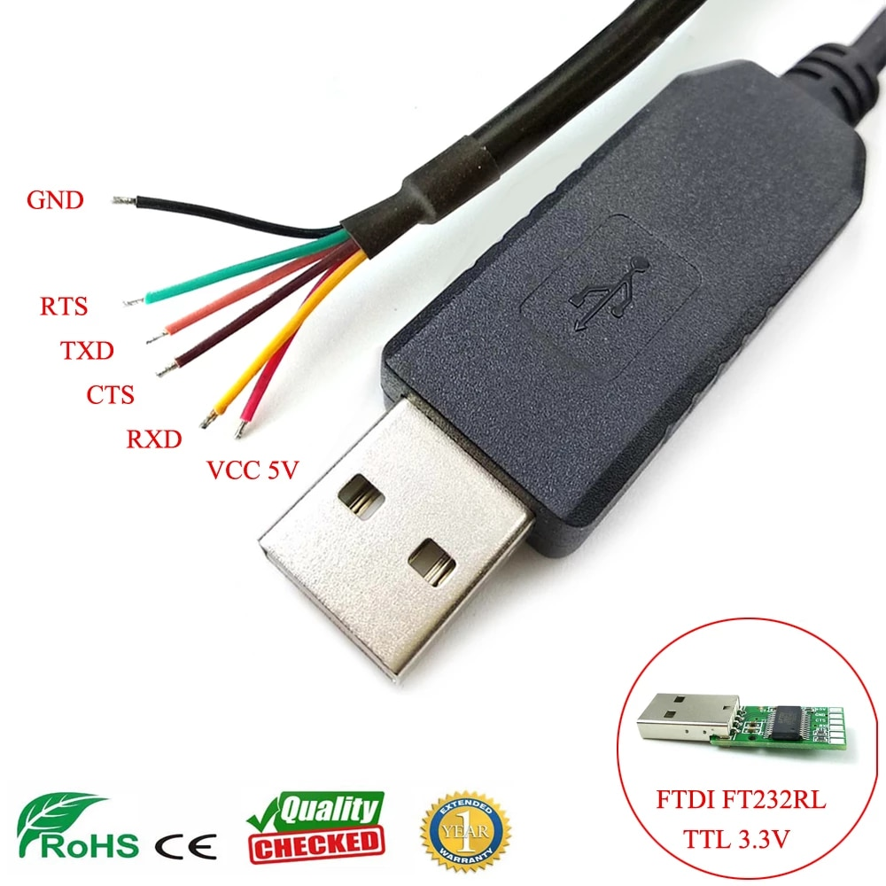
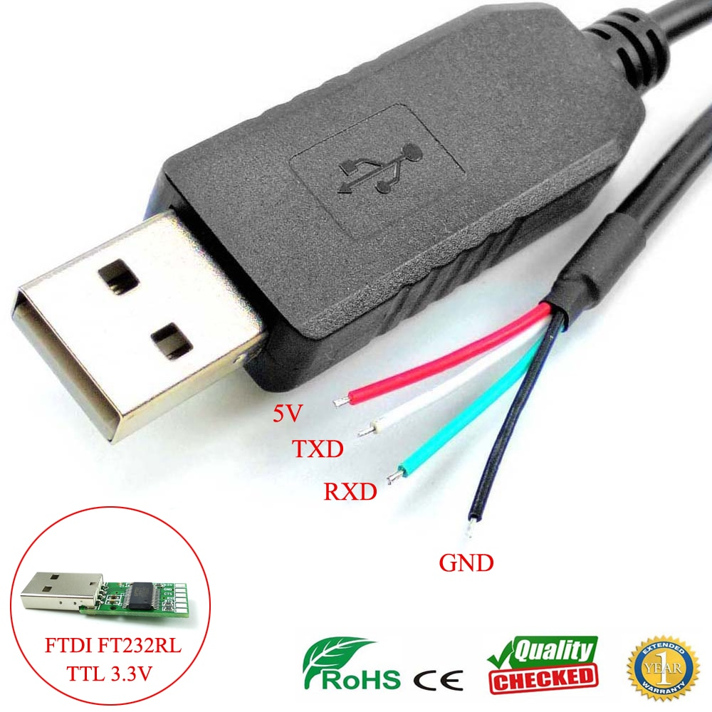
UART v.s. USART

Slide 8
Comparison to EIA-232 & EIA-485
 | EIA-232 | EIA-485
Voltage System | Voltage level-based | Differential
Total Drivers and Receivers | 1 Driver, 1 Receiver | 32 Drivers, 32 Receivers
Line Configuration | Point-to-point | Multidrop
Maximum Operational Distance | 15M / 50FT | 1,200M / 3000FT
Maximum Transmission Rate | 1MBit/s | 10MBit/s
Duplex Mode | Full Duplex | Half Duplex or Full Duplex
Receiver Input Voltage Range | +/-15V | -7V to +12V
資料來源: https://www.seeedstudio.com/blog/2019/12/06/what-is-rs485-and-its-difference-between-rs232/
Notes:
https://www.researchgate.net/figure/2-Traditional-electrical-architecture-based-on-the-CAN-bus-technology-is-shown-at-the_fig1_288994853
https://www.csselectronics.com/screen/page/simple-intro-to-can-bus/language/en
https://kknews.cc/zh-tw/tech/2qm58qe.html
https://www.optcore.net/difference-between-rs-232-rs-422-and-rs-485/

Slide 9
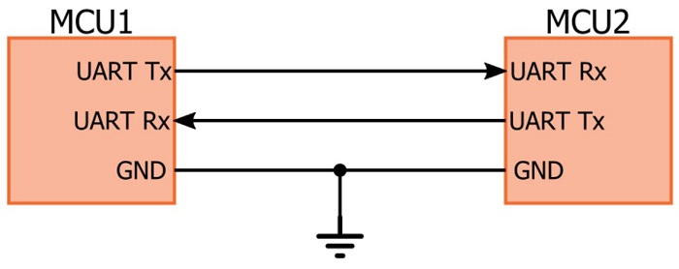
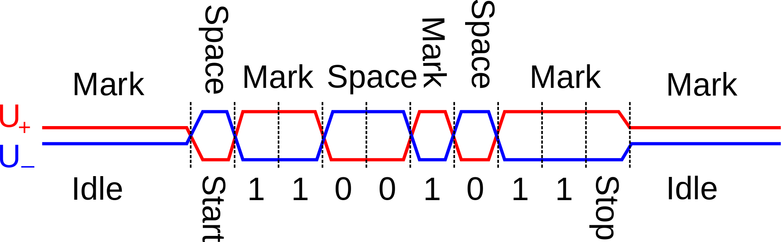
Voltage level-based v.s. Differential
Voltage level-based
Differential
資料來源: https://blog.csdn.net/whuzm08/article/details/80431099

Slide 10
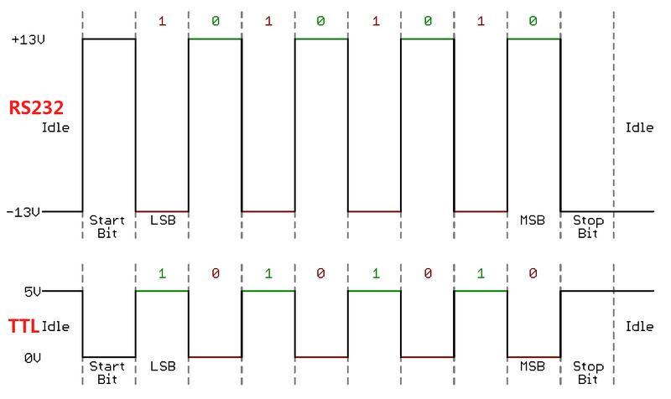
資料來源: https://www.programmersought.com/article/17333563648/
Notes:
https://www.alicat.com/rs-232-communication-protocol-alicat-instrument/

Slide 11
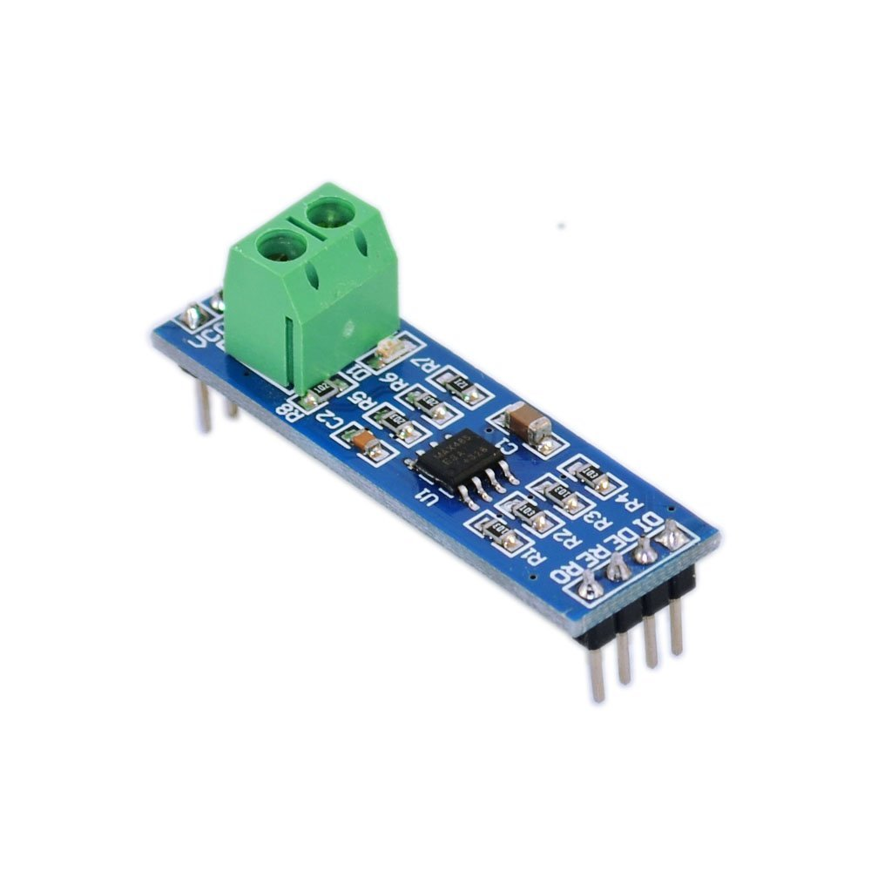
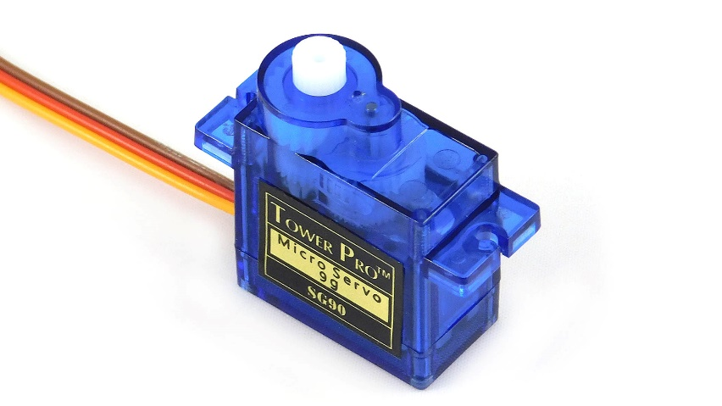
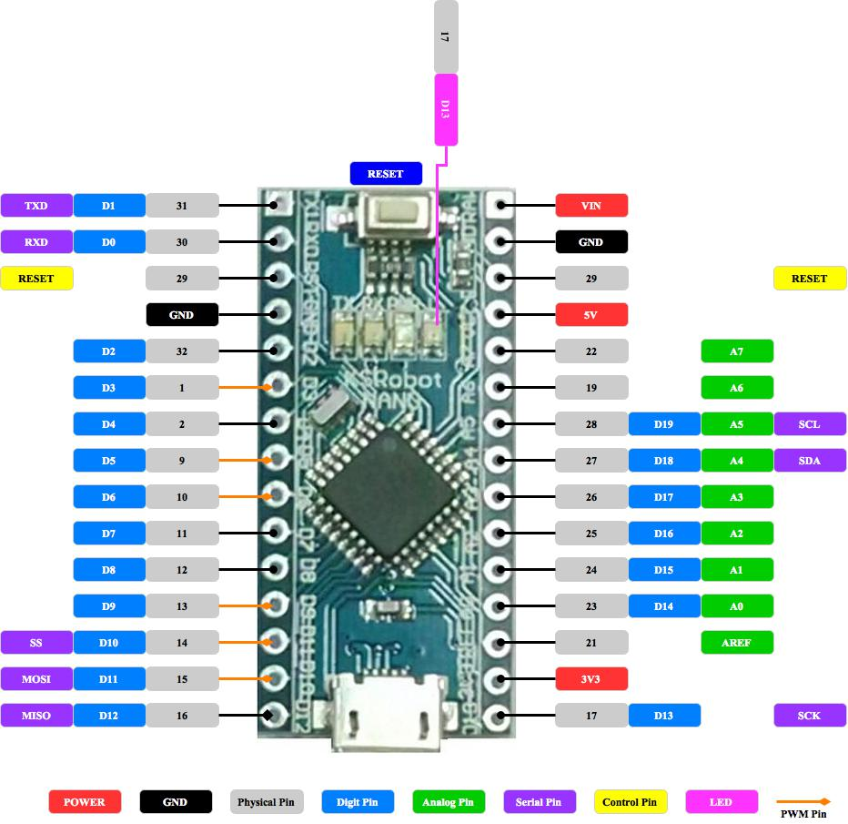
Hardware components
MAX485 UART to EIA-485 converter
10kΩ VR
Arduino NANO
SG90 Servo

Slide 12
MAX-485 UART-to-RS485 Converter Pin out
Vcc: Circuit Voltage Input
GND: Ground
A:
B:
DI: Data In
RO: Receive Out
DE: Data Enable
RE: Receive Enable
} Data Logic Pin
Notes:
邏輯狀態1（off）和0（on），若A電壓比B要低（A-, B+），其狀態為1，若反過來（A+, B-），其狀態為0，不過標準中沒有定義這兩個狀態的邏輯功能。

Slide 13
Pinout diagram for Arduino Nano

Slide 14
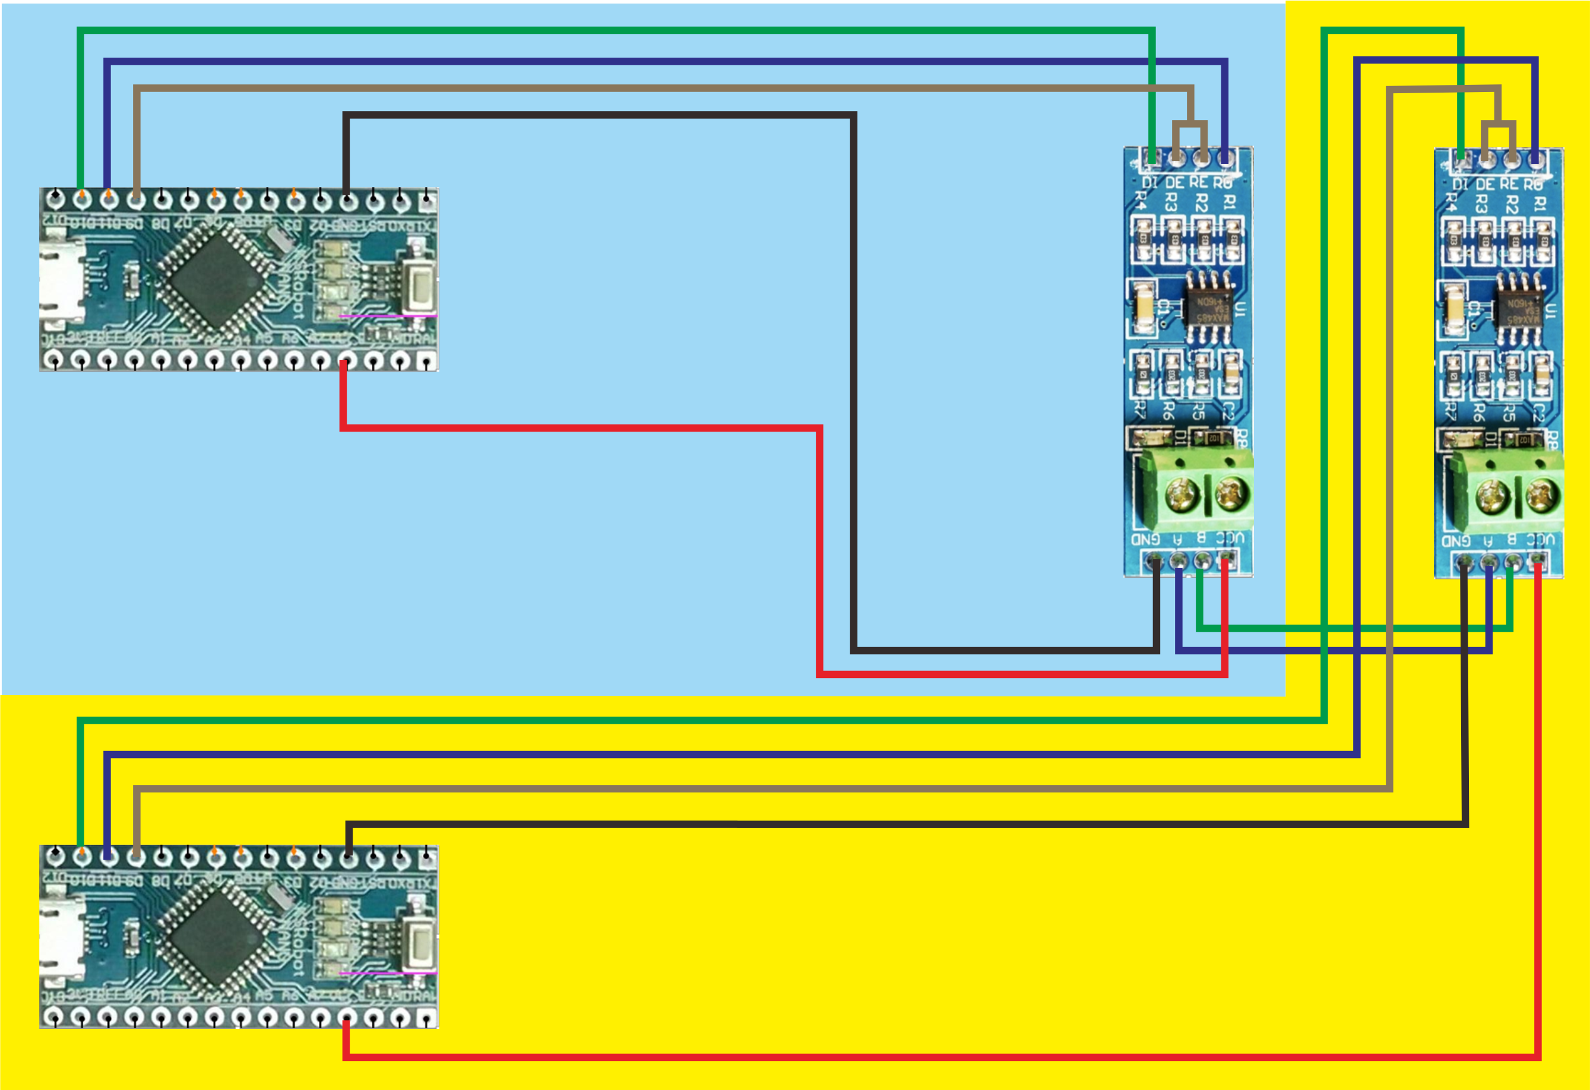
Wiring Diagram

Slide 15
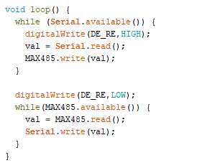
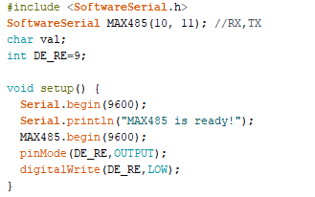
Example

Slide 16
Homework :
Use potential meter to control servo via EIA-485 bus
Control
React

Slide 17
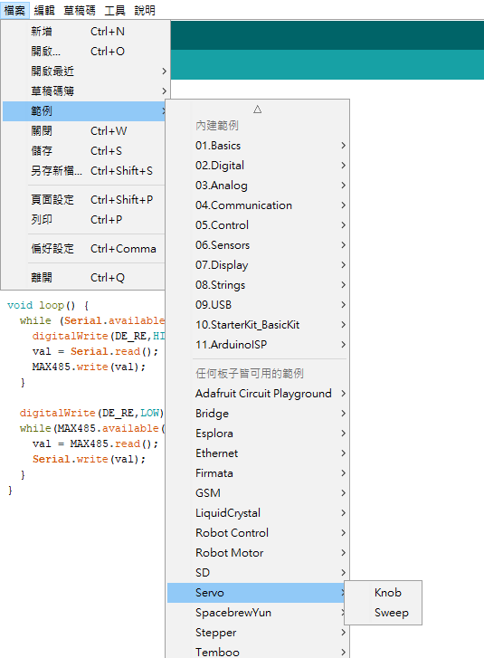
Arduino Examples
Regarding how to use servo,
you can refer to the arduino example

